Slide 1
World Heritage Sites

Slide 2
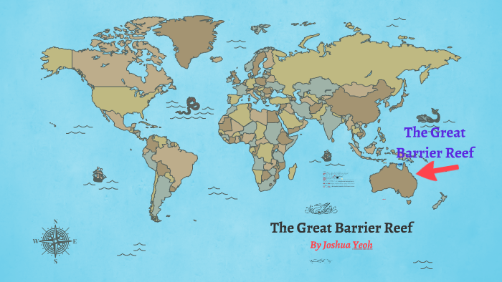
The Great Barrier Reef
The Great Barrier Reef is located off the shore of Queensland in Australia . It is a natural site and the largest coral reef ecosystem on earth, at 348 squared kilometers.
The Great Barrier Reef has many threats including, global warming, human costal development, illegal fishing and bad quality of run off water.
To help protect the Great Barrier Reef from dying, the government has announced a $1 billion boost for the reef protection.

Slide 3
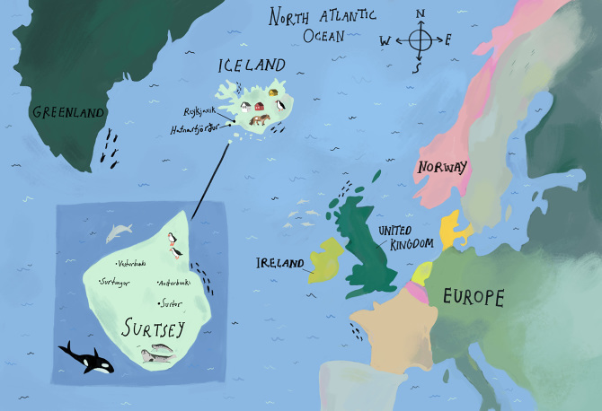
Surtsey
Surtsey is an island located off the coast of Iceland. It is natural site, formed by a volcano eruption.
The site has been legally protected since it birth as it provides the world with a natural laboratory for researching wildlife.
Climate change is expected to have a massive negative impact on the island, as well as the potential for new invasive foreign species .

Slide 4
World Heritage sites
By Talise Rogers-Bouffler

Slide 5
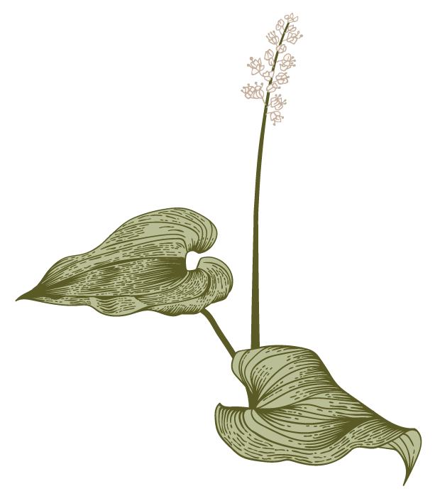
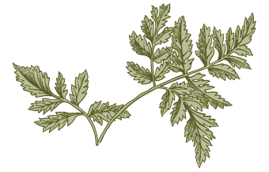
Australia
A
The Great Barrier Reef a natural site which is located on the north-east coast of Australia.

Slide 6
Great Barrier Reef Significance:
The Great Barrier Reef holds the world largest collection of coral reefs, containing 400 different types of coral and 1,500 different species of fish. There are many species on this reef that are very rare and coming to extinction, even though this reef is huge and covers an area of 348,000 square kilometres.

Slide 7
Protection of the Reef
A
Are there any threats to the site?
Threats to the GBR include: improving water quality, reducing loss of coastal habitats, reducing fishing, and adapting to the impacts of climate change.
How is the site being protected?
The Great Barrier Reef Marine Park Authority, an independent Australian Government agency, is responsible for the protection and management of the GBR Marine Park. The Queensland Government is responsible for natural resource management and land use planning for the islands and coast adjacent to the GBR. Other Queensland and Federal legislation also protects the property’s Outstanding Universal Value addressing matters such as water quality, shipping management, sea dumping, fisheries management and environmental protection.

Slide 8
France
F
The Lagoons od New Caledonia are located in the French Pacific ocean and are all natural sites.

Slide 9
Significance of the Lagoons of New Caledonia:
The lagoons feature diverse ranges of coral and fish species with the worlds most diverse concentration of reef structures. The reefs hold healthy populations of large predators and a large number of big fish, however they also hold many threatened marine species. These reefs are considered to be some of the most beautiful reef systems in the world thanks to their variety of shapes within a small area.

Slide 10
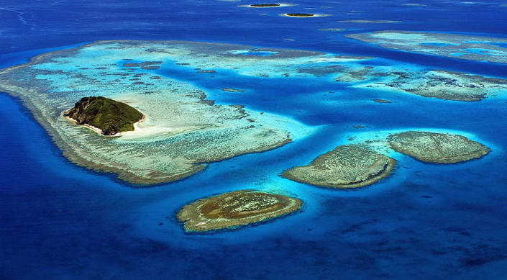

Slide 11
Protection of the site
F
Are there any threats to the site?
Climate change is a continuous threat to this site and the reef managers are seeking to get this managed as much as they can but with tourism in the area and litter growing the reefs are being attacked with plastic and the change of climates and weather conditions.
How is the site being protected?
The property is currently protected by the fisheries legislation, which is being continuously improved, they are also co-managing with the Kanak communities for all clusters. They are protecting and managing large areas in the form of no-take zones and management of the quality of the water, fisheries regulations help maintain reef resilience in the face of climate change.

Slide 12
Great barrier reef
By Harley Heywood

Slide 13
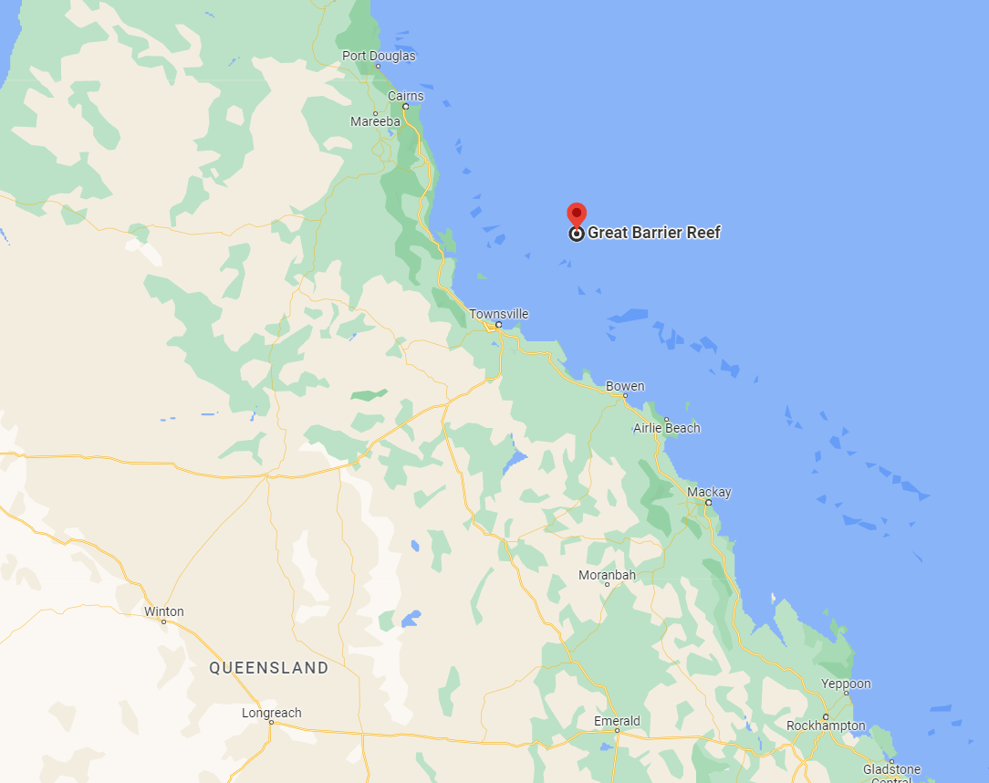
Where is it?
The great barrier reef is located off the east coast of the Queensland mainland, Australia

Slide 14
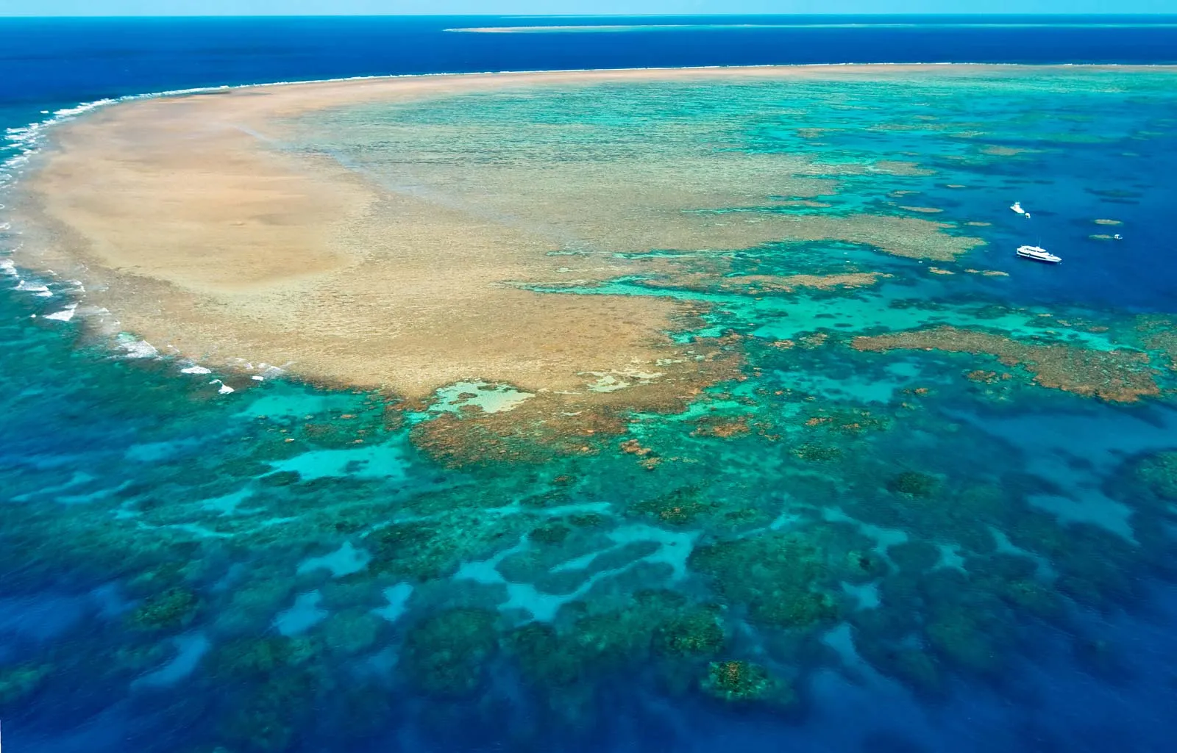
What type of site is it?
The continued occupation of Indigenous people in the area for 60,000 years of what is now known as the Great Barrier Reef a global example of a human culture interacting with the natural environment

Slide 15
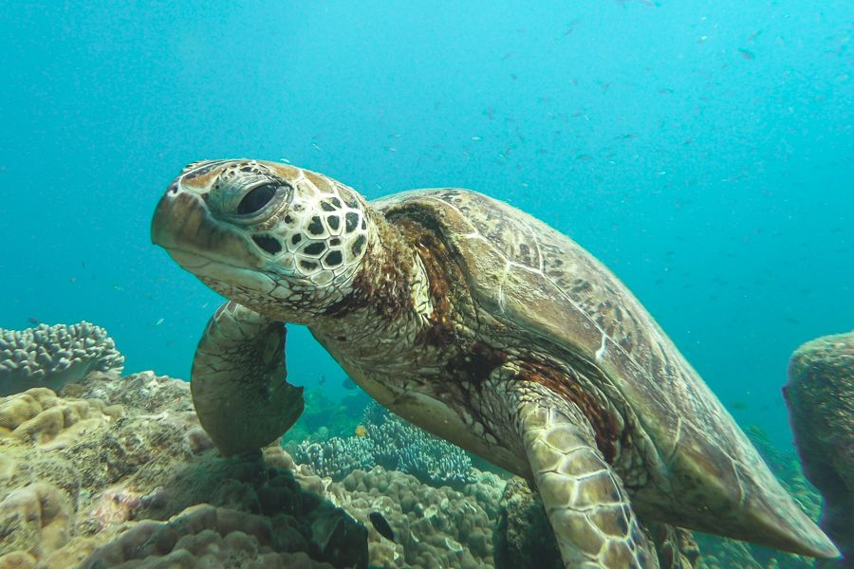
Why is this site significant
The great barrier reef is extremely significant and important to the east coast of Australia as it protects our coastlines and is home to thousands of species of marine life including fish, whales, dolphins and six of the world's seven species of marine turtle

Slide 16
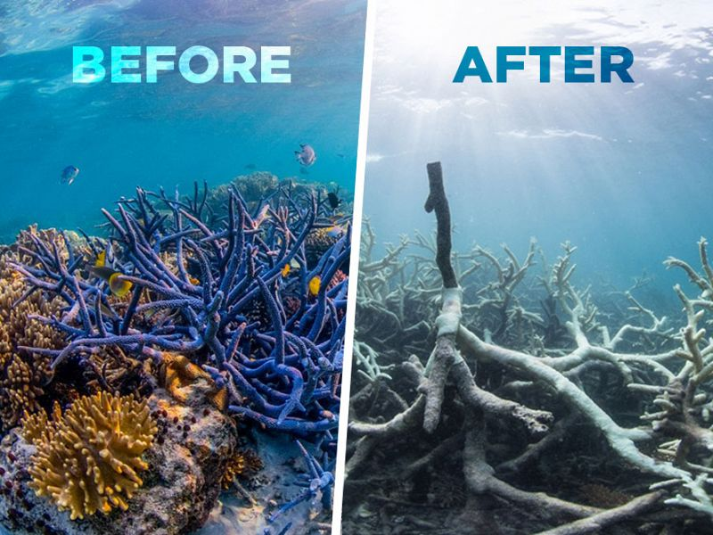
Threats
There are many threats against the great barrier reef, the largest one with the biggest effect being climate change. The other main threats to the Reef including poor water quality from land-based run-off and impacts from coastal development.

Slide 17
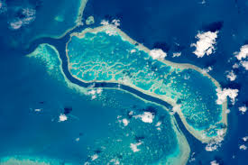
How is it being protected?
The Australian Government has committed over $1.3 billion to the Reef Trust to address the key threats coming towards the reef. The $1.3 billion Reef protection package put into the trust includes a $253 million investment in the Great Barrier Reef Marine Park Authority's key programs over 9 years, remarkably strengthening its capacity to manage and look after this amazing and diverse ecosystem.

Slide 18
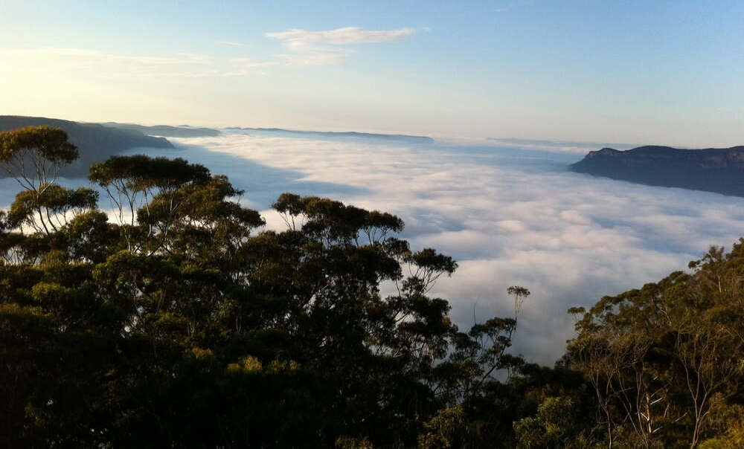
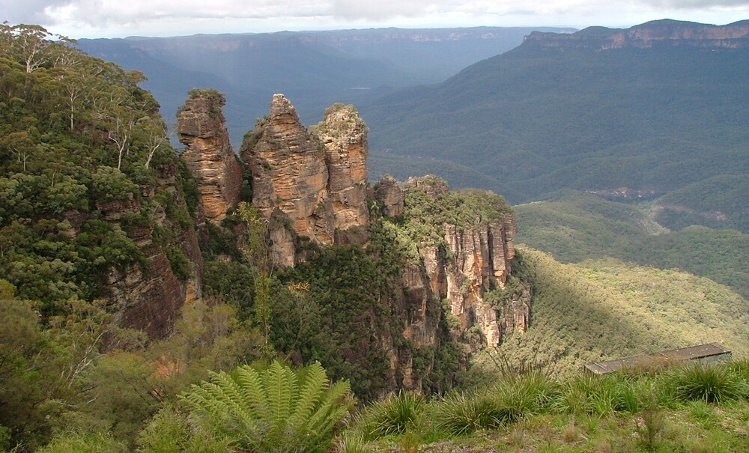
Greater Blue Mountains Area
The Greater Blue Mountains Area is a natural Australian Heritage site found in New South Wales, just outside of Sydney. it has 300 metre tall mountains, waterfalls, slot canyons and land.
The Greater Blue Mountains are important because it shows the evolution of the variation of the eucalyptus trees and the vegetation and animals that live there.
Threats towards the site are climate change and global warming, which have unbalanced the way the forest lives.
It is protected by the legislation of both the Commonwealth of Australia and the State of New South Wales, where it permission is need from the Minister.

Slide 19
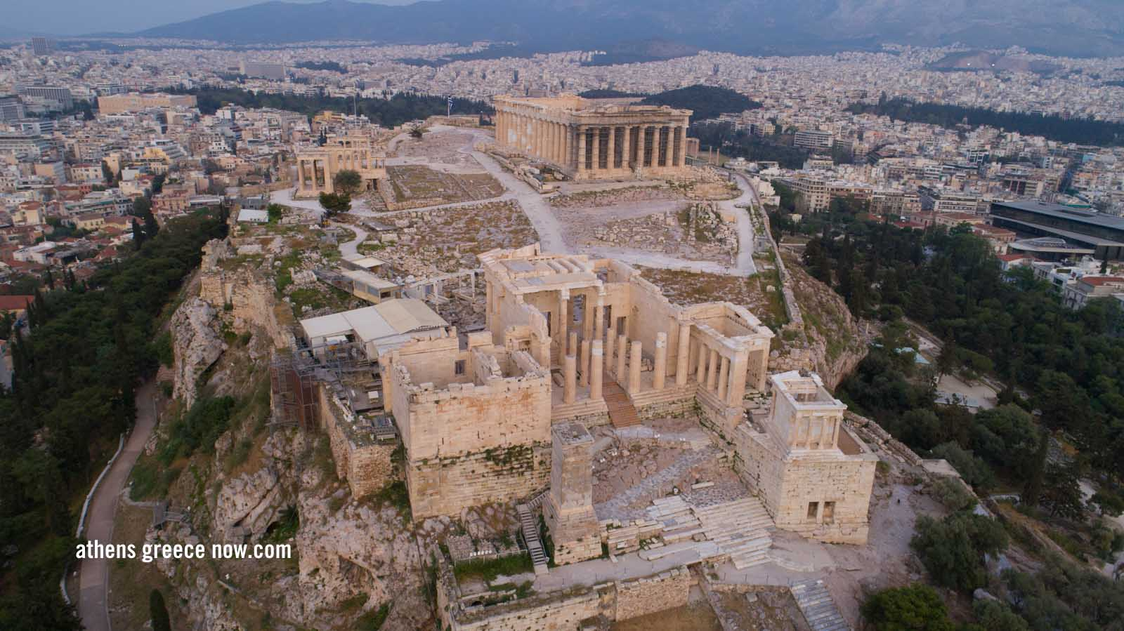
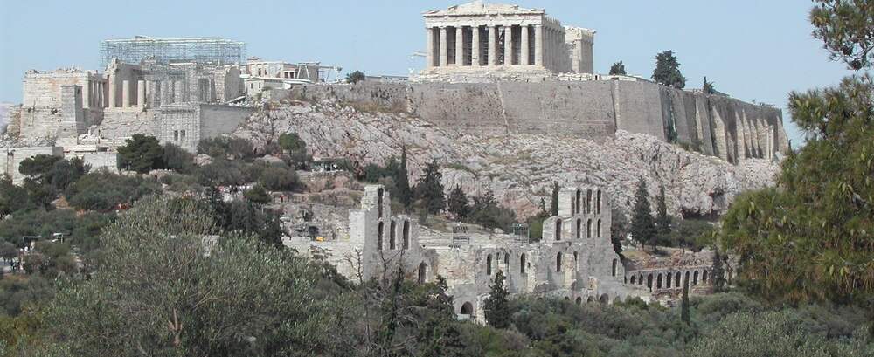
Acropolis of Athens
The Acropolis of Athens is a cultural site based in Greece. It was made by the ancient Greece and was made in the 13th century BC and was built as a home to the war goddess, Athena, the patron goddess of the city. It homes the Parthenon, the building at the top of the hill, the temple dedicated to Athena.
The Acropolis of Athens is an important site because it shows proof of the cultural activity and religion. It has homed kings, showed information on their gods, homed the Greek civilization, and more.
Threats that endanger the city are the acts of climate change, which is contributing to the erosion of the buildings.
It is protected by the law of “Protection of Antiquities and Cultural Heritage in general” in Greece, and legislative decrees. For tourists, paths have been made in certain ways to protect the monuments and other actions, so there is still enjoyment, but protection to keep the site unharmed.

Slide 20
World Heritage Sites
Georgia Copeland and Charli Chivell

Slide 21
Shark Bay- Western Australia

Slide 22
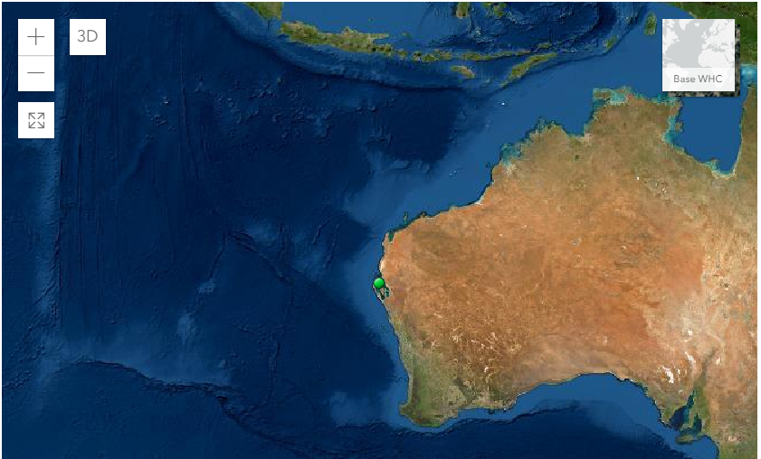
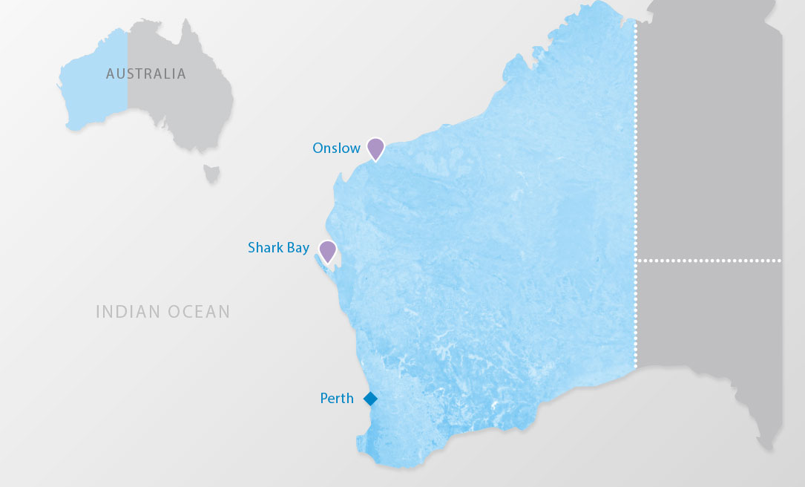
Where is it located?
Shark Bay is located in Western Australia. It sits on the edge of the continent and connects to the ocean.
Is the site a natural, cultural or mixed site?
Shark Bay is a natural site, it contains many unique natural features such as one of the largest and most diverse seagrass beds in the world.

Slide 23
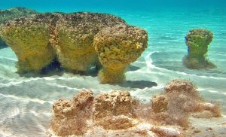
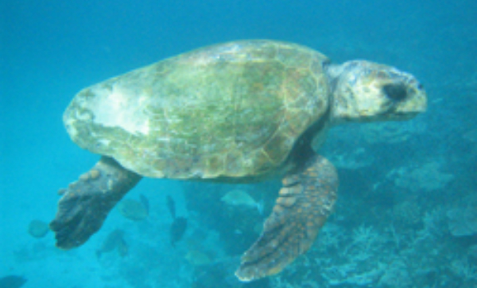
Why is Shark Bay Significant?
Shark Bay is significant because it is home to many types of marine animals. The area that Shark Bay covers (about 2.2 million hectares), 70%of it is marine waters. Shark bay has a lot of diverse flora and fauna, like algae and sea animals. Another one of the interesting things found here is stromatolites, they represent the oldest form of life on Earth and are comparable to living fossils.

Slide 24
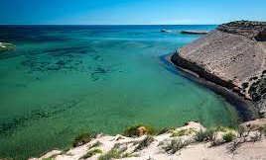
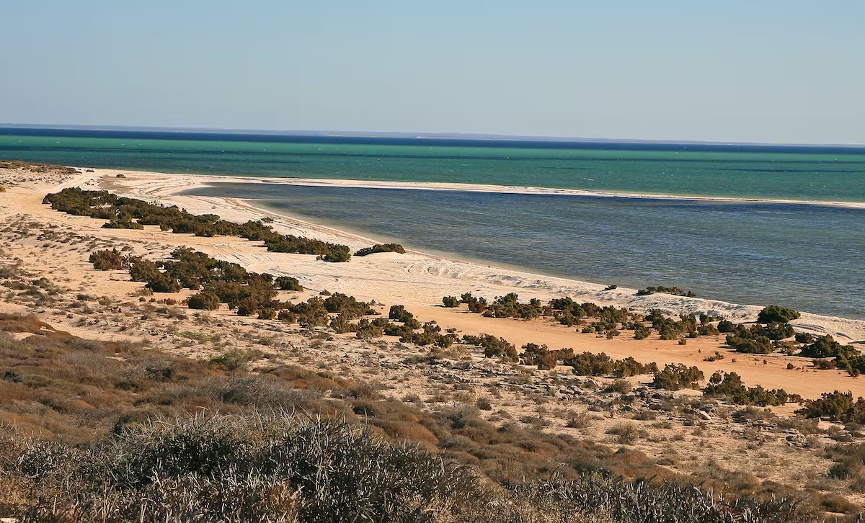
Threats to Shark Bay?
Shark Bay is extremely vulnerable to future climate change. The seagrass is already at its limit and if it gets too hot it will all die, removing an extremely important part of the ecosystem.
Shark Bay is also vulnerable to littering or rubbish. Because there are so many marine animals at Shark Bay, it is important that they don’t get killed by floating plastic or get injured due to the rubbish that has either been left there or blown in from the wind. It would remove another part of the ecosystem there.
How is Shark Bay Being Protected?
Shark Bay is being protected by rules that have been implemented there. They have limited public access to certain areas to reduce the harm done and are taking action to stop the rubbish and being and issue.

Slide 25
Dinosaur Provincial Park- Canada

Slide 26
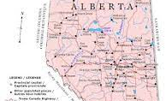
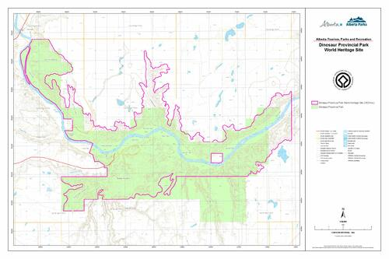
Where is it located?
The Dinosaur Provincial Park is located in Canada, in the heart of the Alberta badlands.
Natural, mixed or cultural site?
The Dinosaur Provincial Park is a mixed site. It has a lot of natural beauty and there have also been fossil discoveries in the area.

Slide 27
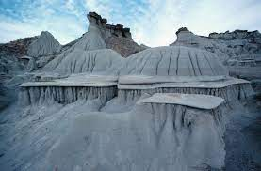
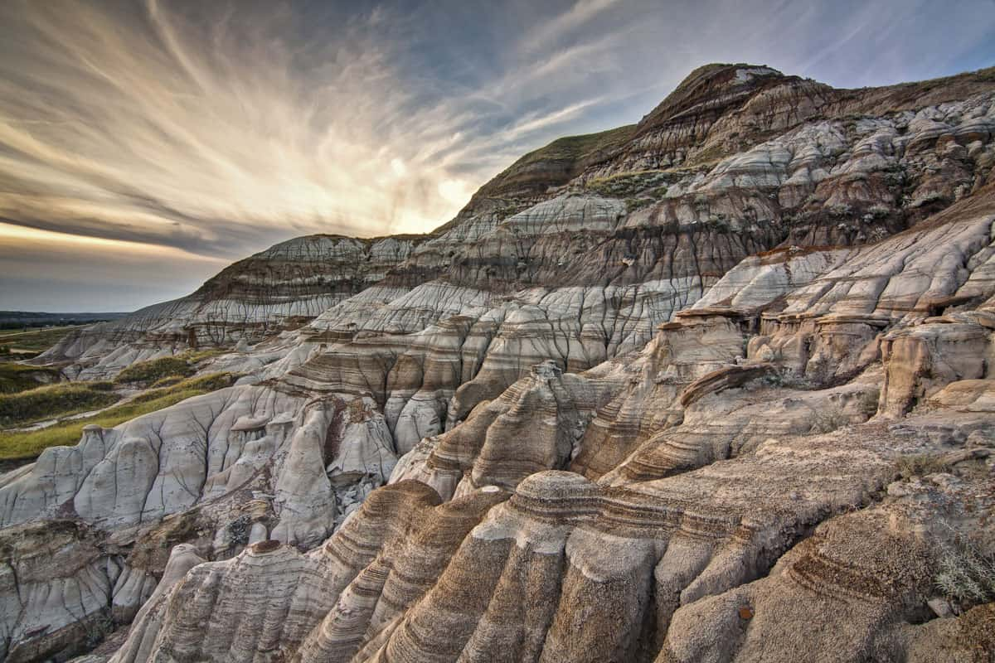
Why is Dinosaur Provincial Park Significant?
Dinosaur Provincial Park is significant because it contains some the oldest fossils ever found. It has about 35 species of dinosaur, some are from 75 million years ago.

Slide 28
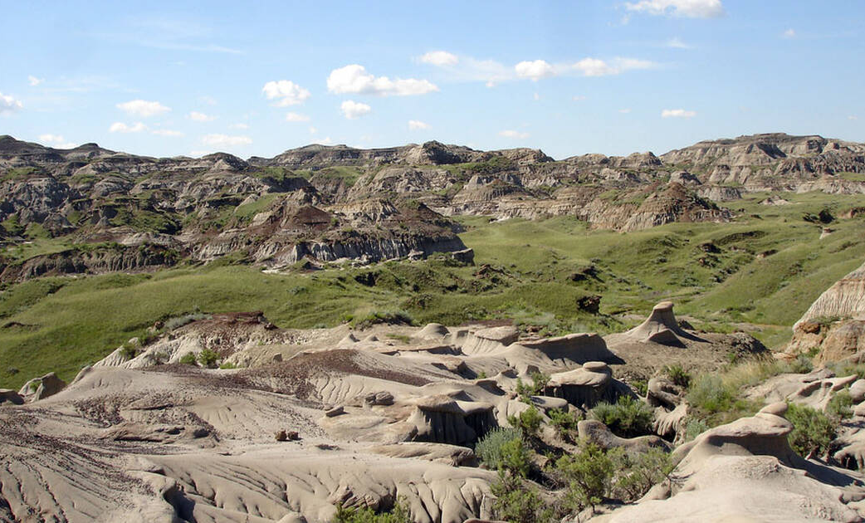
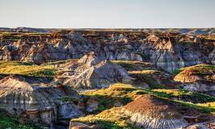
Threats to the site?
The dinosaur provincial park is being threatened by the illegal removal of fossils, invasive plant species, gas exploration and development at the border.
How is the site being protected?
The Dinosaur Provincial Park is being protected by a manager being on site at all times to reduce theft od fossils, and by managing the impact that tourism has.

Slide 29

Hass
World Heritage

Slide 30
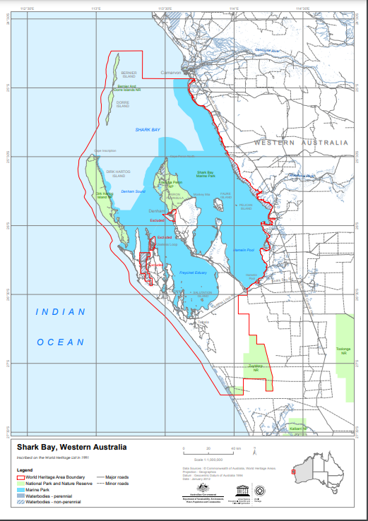
Where is the world heritage site located? Find it on a map
Shark Bay is located on the Indian Ocean coast at almost 800 kms north of Perth at the most westerly point of Australia. Covering a large area of 2.2 million hectares, which is roughly 70percent marine waters.

Slide 31
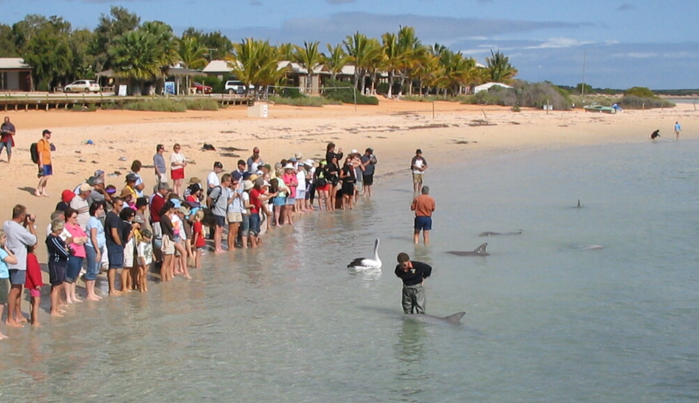
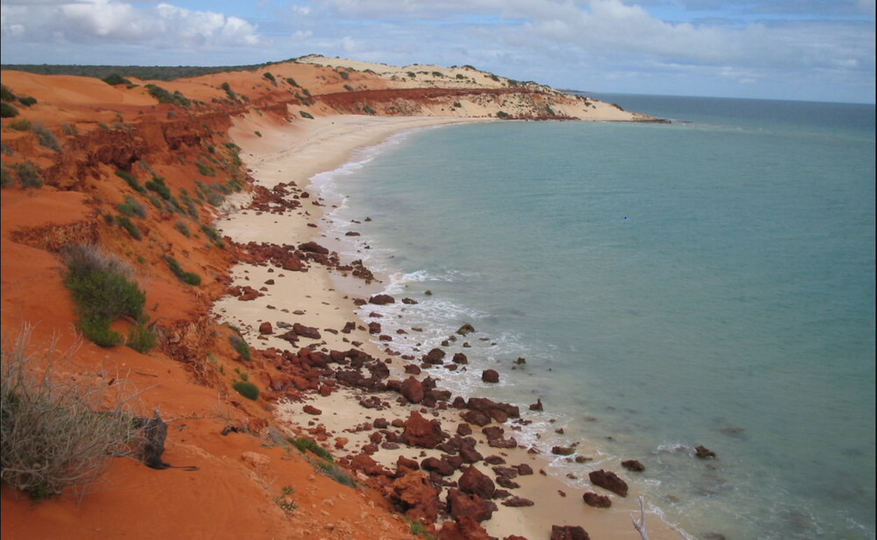
Is its natural, cultural or mixed site?
Shark bay is one of 19 world heritage sites and only one in WA to meet all 4 natural criteria. Shark bay has a coverage of the Hydrologic structure which was formatted by the Faure Sill of evaporation. It also has one of the largest and most diverse seagrass beds in the world.

Slide 32
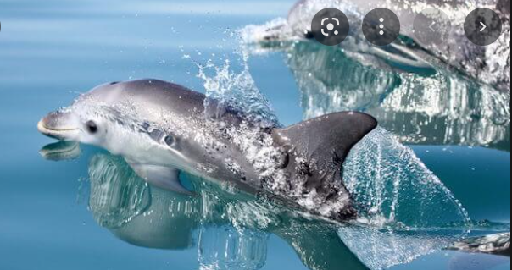
Why is this site significant?
Shark bay is Significant because of its protection of Dugong ( sea- cow) which has a population of 11 thousand, and increasing numbers of Humpback Whales and Southern Right Whales that use Shark Bay as a relocating staging post. Shark Bay has an outgrowing population of bottlenose dolphins that live in the bay. Shark bay has a significant of having its stromatolites (colonies of algae which form hard that are the one of the oldest forms of life on earth. Shark Bay has a currenta population of 28 different spices of sharks within the bay as well.

Slide 33
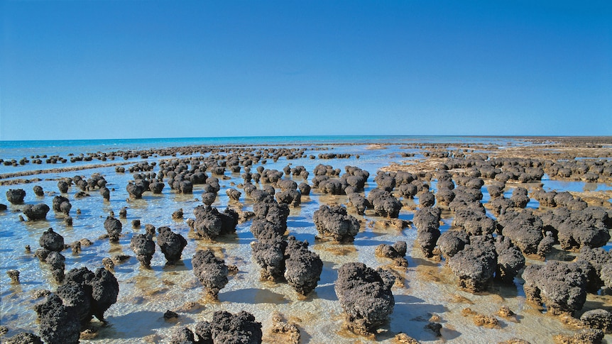
Are there any threats to the site?
Shark Bay is under threats of climate change , including marine heat waves and increased storms. Shark bay also has a population of 5 globally threatened mammals, plants and reptile species that they have to take good care of. Gypsum mining and slat activity may comprised a threat if not taken care of and also tourism and recreational boating is also in this care.

Slide 34
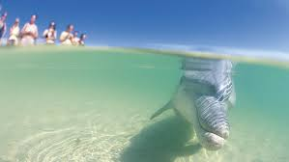
How is the site being protected?
Shark bay is currently being protected by Shark Bay World Heritage Advisory Committee that have a bunch of strategies and management plans. They also have the state government helping with this.Shark Bay are also working towards protecting all their pools/beaches etc so no threats happen to appear.

Slide 35
Dinosaur Provincial Park in Canada
By cora

Slide 36
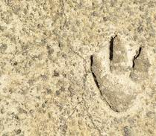
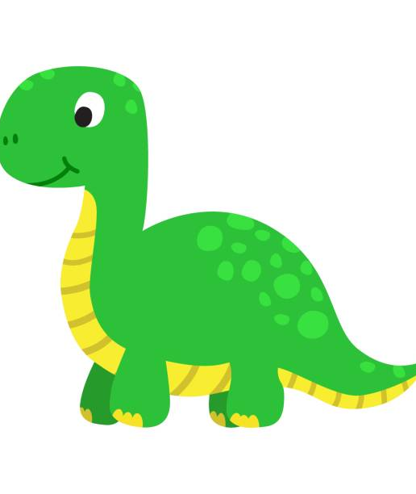
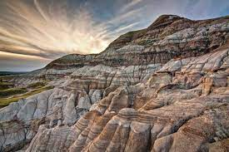
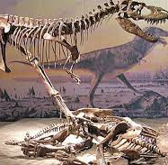
Is it a natural, cultural or mixed site
The dinosaur provincial park is a natural site

Slide 37
Why is it significant
Dinosaur Provincial Park contains some of the most important fossil specimens discovered from the “Age of Dinosaurs” period of Earth’s history. The property is unmatched in terms of the number and variety of high-quality specimens which, to date, represent more than 44 species, 34 genera and 10 families of dinosaurs, dating back 75-77 million years. The park contains exceptional riparian habitat features as well as Badlands of outstanding aesthetic value.

Slide 38
Is there any threats to this park
There are a number of current threats, including illegal removal of fossils, gas exploration and development at the perimeter of the site, and invasive plant species.

Slide 39
How is it being protected
The protection and management of the property is enabled through a number of different statutes of the Province of Alberta, notably the Provincial Parks Act and the Historic Resources Act. Strong collaboration with stakeholders and local landowners in relation to management issues is occurring on an ongoing basis.

Slide 40
World Heritage Site
Lourisse Asuncion

Slide 41
Macquarie Island, Australia
Where is the site located?
The island is an oceanic island in the Southern Ocean lying east of Tasmania and approximately halfway between Australia and the Antarctic continent.
Is it a natural, cultural, or mixed site?
The Macquarie Island is a natural site.
Why is the site significant?
The site is significant as it contains rocks from the earth’s mantle that are being actively exposed above sea level. The unique exposures provide a complete section of the structure and composition of both the oceanic crust and the upper mantle. It provides evidence of ‘sea floor spreading’ and tectonic processes that have operated for hundreds of millions of years.
Are there any threats to the site?
Human impacts, the exploitation of seals and penguins, along with the introduction of alien species and pathogens have resulted in the extinction of native species and threatens to contribute to further decrease in other species. The site is also vulnerable to the consequences of anthropogenic climate change.
How is the site being protected?
The introduction of new species and pathogens is being monitored and managed. A project was undertook to eradicate the remaining mammalian pest species. Its surrounding waters is managed as a nature reserve by the Tasmanian Parks and Wildlife Service (PSW).
A

Slide 42
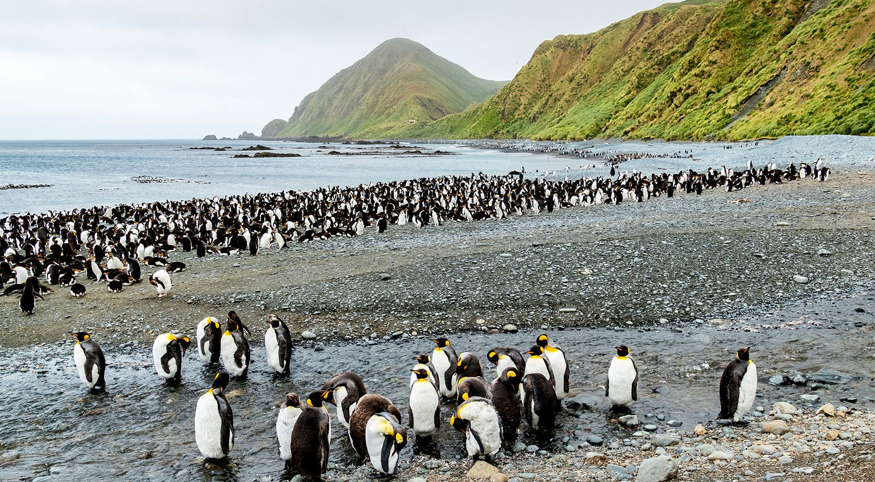

Slide 43
Bordeaux, Port of the Moon, France
Where is the site located?
The Port of the Moon is a city of Bordeaux in south-west France.
Is it a natural, cultural, or mixed site?
The Port of the Moon is a cultural site.
Why is the site significant?
The city is inscribed as an inhabited historic city. It is an example of the exchange of human values for over two thousand years due to its role as capital city of a world famous wine production region and the importance of its port in commerce at regional and international regions.
Are there any threats to the site?
There are no current known threats to the site.
How is the site being protected?
The historic town is being protected by the “Plan de sauvegarde et de mise valeur” (PSMV). A buffer zone has been established. Several plans ensure the conservation and management of the property, taking into account of historic preservation and heritage character.

Slide 44
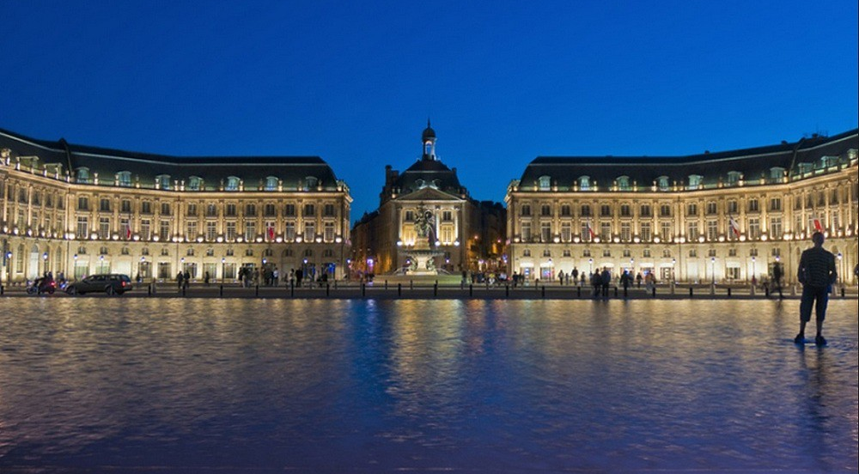

Slide 45
World heritage sites
Alannah Culbert

Slide 46
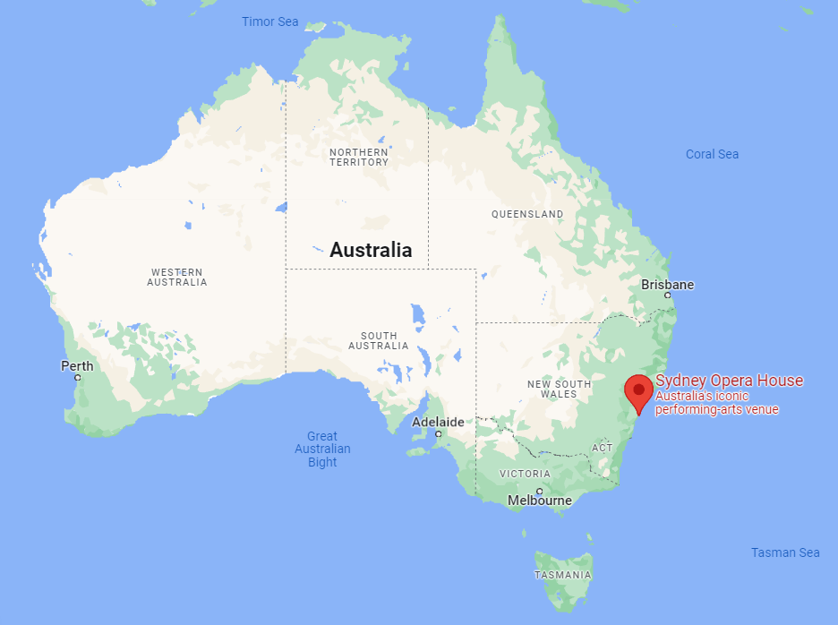
Sydney opera house
Where is it located? →
Is it a natural, cultural or mixed site?
Cultural
Why is the site significant?
the Sydney opera house is considered a masterpiece of 20th century architecture, and is known all over the world. “it represents multiple strands of creativity, both in architectural form and structural design.”
Are there any threats to the site?
The only major threat is climate change, as rising sea and salt levels could erode the opera houses’ supports (25m below sea level).
How is the site being protected?
The opera house goes through “regular and rigorous repair and conservation programmes” (this is all I could find ☹)

Slide 47
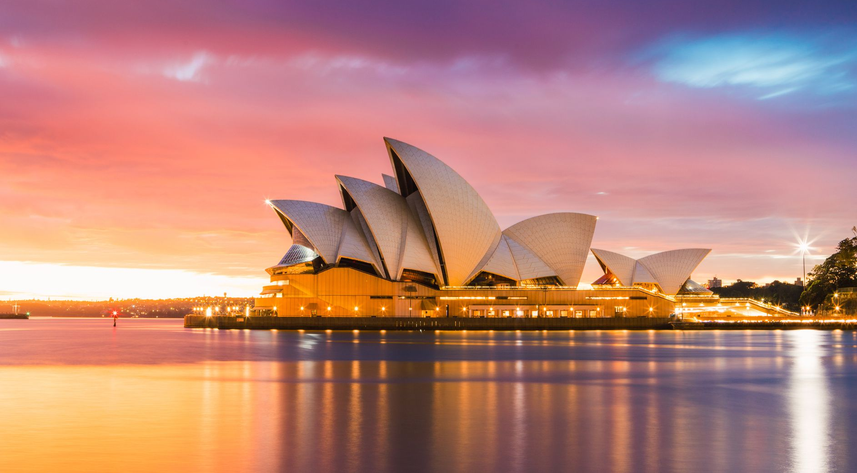

Slide 48
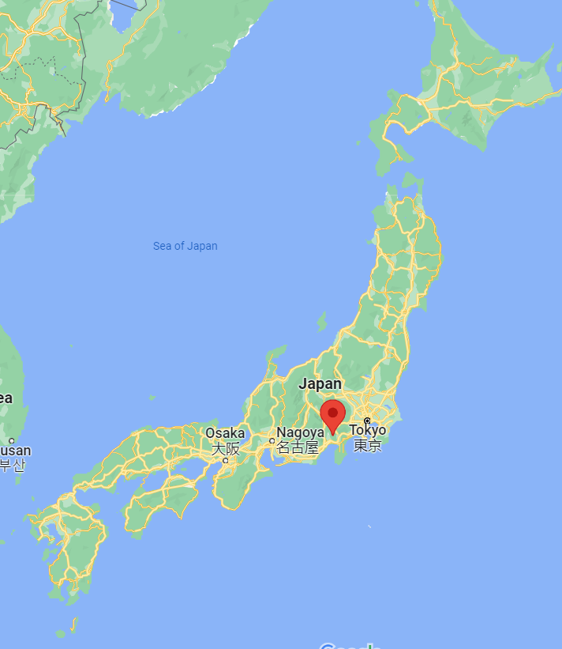
Mount Fuji (Fujisan)
where is the site located? →
Is it a natural, cultural or mixed site?
Cultural
Why is the site significant?
Mount fuji is considered a sacred kami (god)in the Shinto religion, and followers of the Shinto religion climb it as an act of pilgrimage.
Are there any threats to the site?
The main threat to Fujisan is the amount of waste being left on it, despite the number of people climbing it steadily declining
How is the site being protected?
The prefectural governments of Shizuoka and Yamanashi passed the “Fuji charter” in 1988, which caused a movement to reinstate Fujisan as a Japanese symbol. There is also a “Fuji clean-up climb” every August!

Slide 49
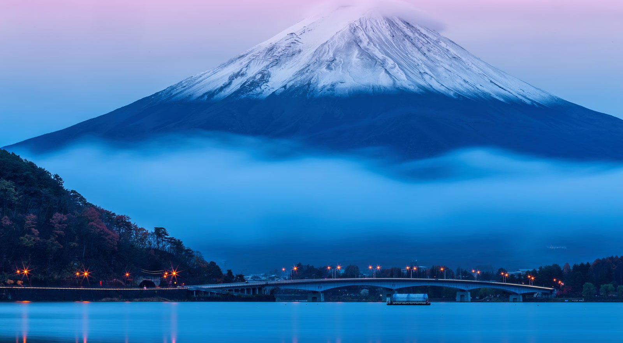

Slide 50
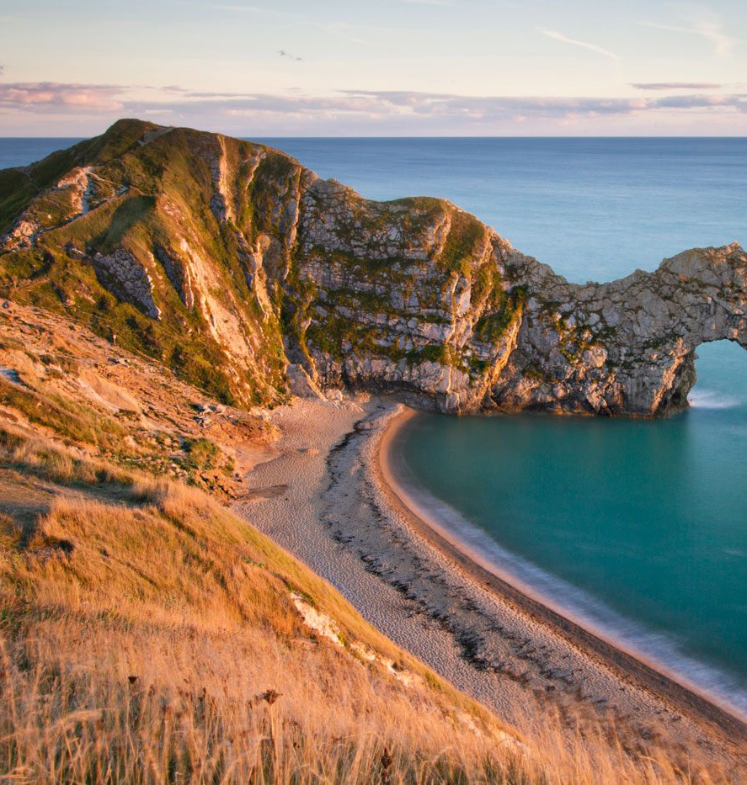

Durdle Door

Slide 51
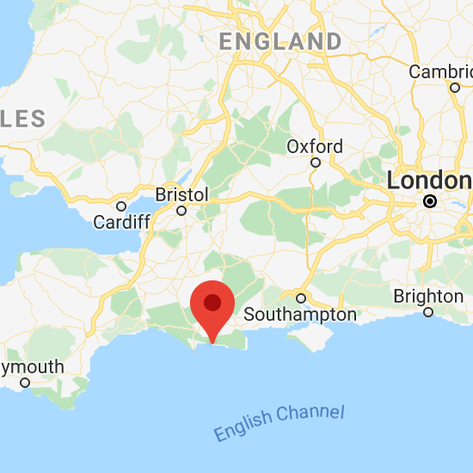
Where is it?
Durdle Door is one of Dorset's most photographed and iconic landmarks. It is part of the Jurassic Coast World Heritage Site and is an extremely popular beauty spot. It is located on the Lulworth Estate in south Dorset and is part of the Jurassic Coast.

Slide 52
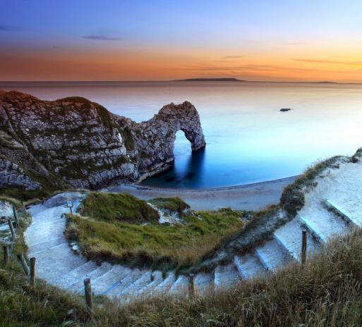
Is it a cultural, natural or mixed site?
Durdle Door is one of the Jurassic Coast's most iconic landscapes. It is a natural arch, formed from a layer of hard limestone standing almost vertically out of the sea. Durdle Door stands at the foot of a steep path followed by a set of wooden steps.

Slide 53
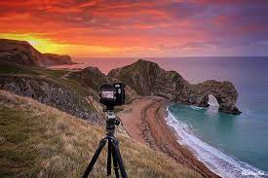
Why is it significant?
Durdle Door is probably the most famous stone arch anywhere in the world. It was created when the sea pierced through the Portland limestone around 10,000 years ago. Looking west over the beach, isolated stacks out at sea show where an older coastline once lay.

Slide 54
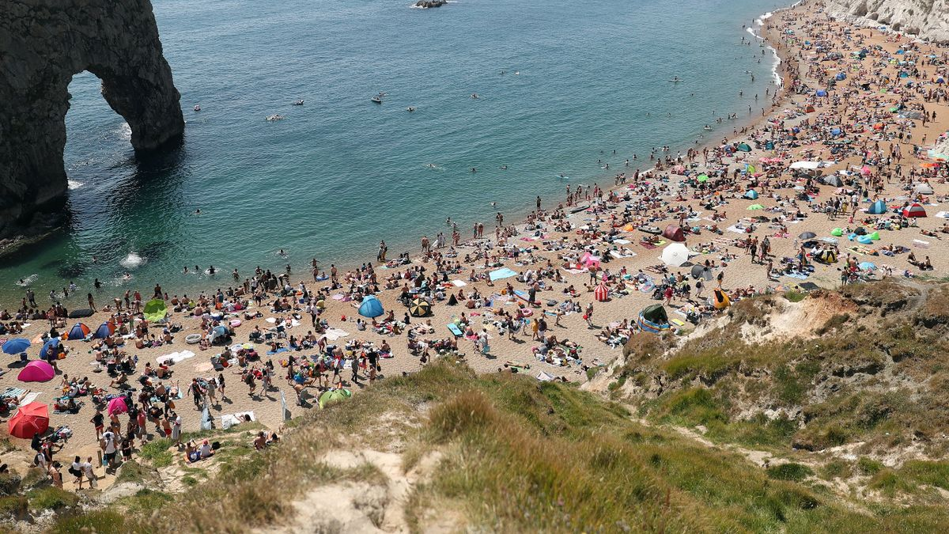
Are there any threats to the site?
“These arches are natural features in our landscape and with time they do erode and they will eventually collapse,” said Dr Sally Brown, geomorphologist at Bournemouth University.
It seems the collapse of this iconic arch could happen in a couple of ways. The first is through natural weathering and the other through erosion from the base of the cliffs.
“The water and the waves would eat away at the base until those stacks get a lot thinner and then they’re unable to support the weight of the arch and then the arch collapses,” Dr Brown said. Though it’s unlikely that the collapse would harm anyone, the possibility isn’t zero.
“It can collapse, a bit like cliffs, all of a sudden without any warning. And if that happened, it could cause a big wave coming into the shore,” Dr Brown warned.

Slide 55
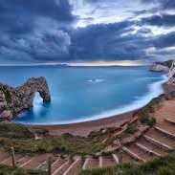
How is durdle door being protected?
This coast protection scheme was constructed in 1994 and comprises a steel sheet piled, stepped concrete sea wall, rock groyne and rock armour protection. We monitor these defences and associated works and carry out maintenance works as necessary.

Slide 56
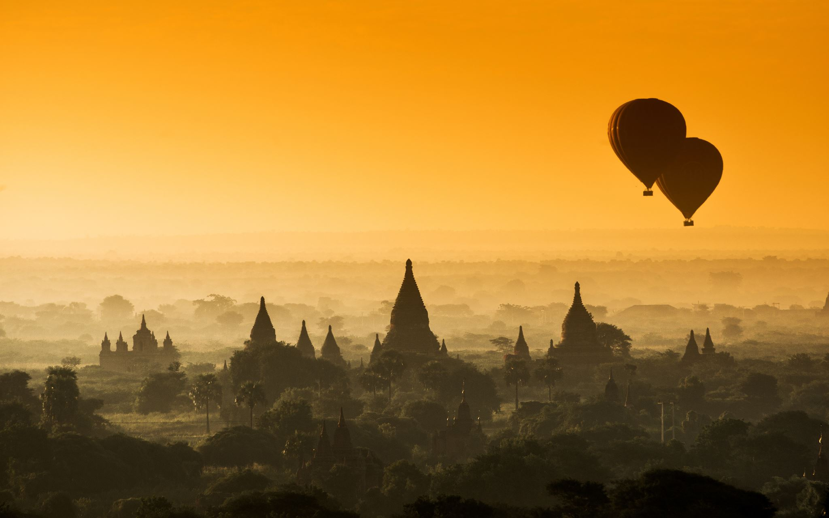
World Heritage Sites
Guillaume van der Riet

Slide 57
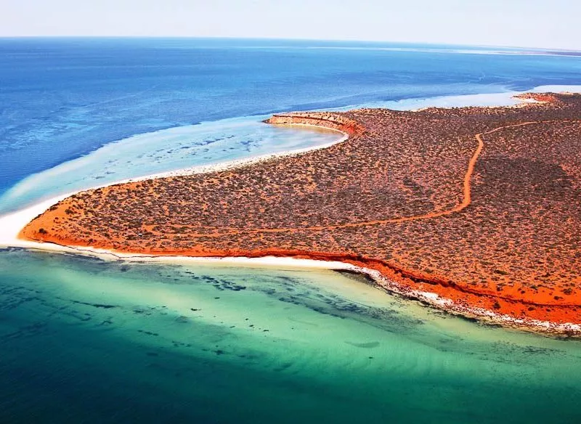
Ningaloo Coast
Western Australia

Slide 58

Where is the Ningaloo Coast?
The Ningaloo Coast is located on Western Australia's remote coast along the East Indian Ocean. The interconnected ocean and arid coast form aesthetically striking landscapes and seascapes.

Slide 59

What Type of Site is the Ningaloo Coast?
The Ningaloo Coast is considered a natural heritage site, listed so because of its natural features, geological and physiographical formations and delineated areas that constitute the habitat of threatened species of animals, plants and natural sites of value from the point of view of science, conservation and natural beauty.

Slide 60

Why is the Ningaloo Coast Significant?
The Ningaloo Coast supports over 1000 species of living organisms, including breeding sites for turtles, humpback whales and whale sharks. The Reef and coastline contribute $110 million annually to the local economy and support over 1000 jobs.

Slide 61
Ningaloo Reef threats
Climate change is one of the key threats facing coral reefs around the world, and the impacts of coral bleaching, ocean acidification and changing environmental conditions are predicted to affect Ningaloo in coming future.

Slide 62


How is the site being protected?
The government announced that it will protect Exmouth Gulf on Western Australia's Ningaloo Coast by implementing a variety of conservation measures, including the formation of new conservation reserves in areas where major industrial developments were proposed

Slide 63

Mont Saint Michel
World Heritage Site

Slide 64
Where is Mont Saint Michel?
Mont Saint Michel is a tidal island and commune in Normandy, France.
Ur

Slide 65
WORLD HERITAGE SITES
By Dekoda-Marie and Leah

Slide 66

Discovery coast Atlantic forest reserves
Brazil

Slide 67

Location
Located between the southern coast of Bahia and the northern coast of Espirito Santo, the Discovery Coast Atlantic Forest Reserve is made up of eight separate protected areas containing representative remnants of the Atlantic Forest and some coastal shrub vegetation.

Slide 68

Natural, Cultural, or mixed?
The Discovery Coast Atlantic Forest Reserves are a natural site.

Slide 69

Why is this site significant?
The Discovery Coast Atlantic Forest Reserve is highly significant due to being one of the richest tropical forest areas in the world in terms of biodiversity. It contains about 20% of the world's flora, including 627 endangered species.

Slide 70

Are there any threats to the site?
The main current threat is the biological and ecological isolation of relatively small forest fragments, leading to erosion of biodiversity in the long term. Other threats include increased commercial land use, fires and logging, as well as ongoing illegal hunting in wider areas.

Slide 71

How can the site be protected?
Key conservation challenges include monitoring deforestation and slash-and-burn in buffer zones, improving cooperation with local Patakso Indians, developing environmental education campaigns, and considering and recommending new protected areas. These methods are currently being implemented by local and federal governments.

Slide 72


Godwana Rainforests
Australia

Slide 73

The Gondwana Rainforests
The Gondwana Rainforests of Australia is located on the major remaining areas of rainforest in southeast Queensland and northeast New South Wales.

Slide 74

Is it a natural, cultural OR MIXED SITE?
The Gondwana Rainforest is a natural site. It is a wide spread of rainforest.

Slide 75

Why are the Gondwana rainforests significant?
The Gondwana Rainforests is important because it's an environment that supports the principal habitats for many species of plants and animal. Many of these animals and plants are of important value. The Gondwana Rainforest is home to more than 270 threatened species as well as relict and primitive taxa.

Slide 76

What are the threats to the Gondwana rainforest?
The Gondwana Rainforest forces many threats. The threats of increasing climate change and high levels of visitation, pests, wildfires, deforestation, decrease of species and plants all impact the Gondwana rainforest.

Slide 77

How can the site be protected?
Undertaking effective fire management and mitigating the effects of invasion by pest species and pathogens can provided protection to the Gondwana Rainforests.

Slide 78
Yosemite national park
By Lucas and Tiny

Slide 79

Where is the site located
East central California 225 km east of san fransisco.

Slide 80

Is it a natural site or mixed
The Yosemite National Park is a natural site

Slide 81

Why is it important
Yosemite National Park has the distinction of being the first scenic natural area to be set aside by the United States for public benefit and appreciation of landscape beauty. Yosemite Valley and the Mariposa Grove were the 1864 birthplace of the national park idea, which has spread throughout the world.

Slide 82
Any treats to the site
Current threats to the integrity of the Yosemite National Park World Heritage site include over-development, unregulated day use, air pollution, invasive species and altered fire regimes.

Slide 83

How is the site being protected
More than 94% of Yosemite is designated as Yosemite Wilderness, contributing to one of the largest contiguous areas of protected wilderness in the lower 48 states. Additionally, 135 miles of the Merced and Tuolumne Rivers are designated as part of the national wild and scenic river system.

Slide 84


Slide 85


Slide 86


Slide 87


Slide 88


Slide 89


Slide 90


Slide 91


Slide 92


Slide 93


Slide 94


Slide 95


Slide 96


